Slide 1
IPAC Update
Family and Friends Council September 19, 2024

Slide 2
Agenda
Hand Hygiene Campaign
Update on Vaccines
Outbreak Management
Antimicrobial Stewardship

Slide 3
Hand hygiene
Crucial for preventing the spread of infection.
  Hands can easily spread germs so it is important to practice good hand hygiene and clean your hands regularly
Involvement of families, friends, visitors and residents can contribute to hand hygiene compliance within the home
  New Campaign - ask me if I cleaned my hands

Slide 4

Ask me if I cleaned my hands
Buttons are designed for staff to wear to encourage conversations about hand hygiene
Buttons also represent their commitment and dedication to hand hygiene practices

Slide 5
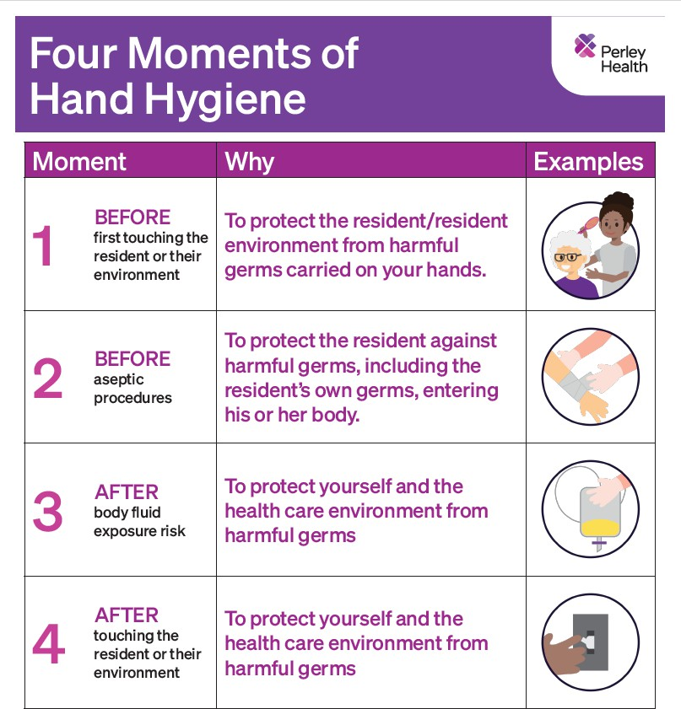
Four Moments
Increase audits
  moment one and four
Education
  posters
  just in time coaching
  on-line training

Slide 6
Publicly Funded Vaccines
Influenza
COVID-19
Pneumococcal
Respiratory syncytial virus (RSV)
Tetanus and Diphtheria (Td)
Tetanus, Diphtheria and Pertussis (Tdap)

Slide 7
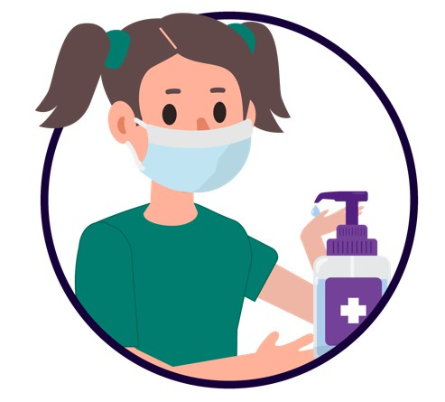
Outbreak Management
Strong surveillance program = early detection
  rapid communication of suspected cases
  just-in-time targeted training
Immediate implementation of control measures
  suspect and confirmed
Increase in audits
Debrief following each outbreak

Slide 8
Antimicrobial Stewardship
A collaborative effort that aims to ensure the best use of antimicrobial therapy
Involves evaluating whether antimicrobials are necessary and if so
  determining the appropriate choice, dosage, method and duration of treatment
Areas of focus
  urinary, respiratory and wound infections

Slide 9
Project Components
Educating the Care Team
  prevention of infections
  signs and symptoms of infections
  specimen collection
  documentation
Optimizing communication with Physicians
  targeted SBAR
Time out
  assessment of an antibiotic Rx with 72 hours

Slide 10

Thank you
We welcome your questions
IPAC@perleyhealth.ca

