Slide 1

2023 Resident & Family QOL Survey Results
Family and Friends Council April 18, 2024

Slide 2

Update: 2021-2022 Resident and Family Survey Results
Meaningful Activities
Dining Experience

Slide 3
Resident Social Life Resident Team
Team Leads:
Laura Torontow, Recreation Therapist
Jennifer Parker, Allied Health Lead

Slide 4
Process and Timelines
Area of focus: “I participate in meaningful activities”
Key Milestones in 2023:
  Focus groups
  Determining initial change ideas
  Testing change ideas

Slide 5
Change Ideas
Introduce more intellectual programs into the calendar
  Advanced Trivia
  Lecture Series
- Documentary nights, book clubs
Proposed
Calendar Changes
  Master calendar in cafeteria
  Special events calendar
- Activities calendar on website and on TVs
Proposed

Slide 6
Change Ideas (cont’d)
Timing of Programs
  Changes in the timing of some programs to allow residents to attend more options

Slide 7
Next Steps
Evaluate impact of changes to date and adapt as needed
Further changes to calendars and programming

Slide 8
Resident Social Life Family Team
Project Leads
Andrea Liu, Manager, Interprofessional Care
Daniela Acosta, Manager, Education and Knowledge Translation

Slide 9
Progress to date
All About Me
  Tailored the existing “Getting to Know Me” tools to include focus on social engagement
  Updated process for new admissions and existing residents
  Updated poster template
  Created an online form for populating the poster

Slide 10
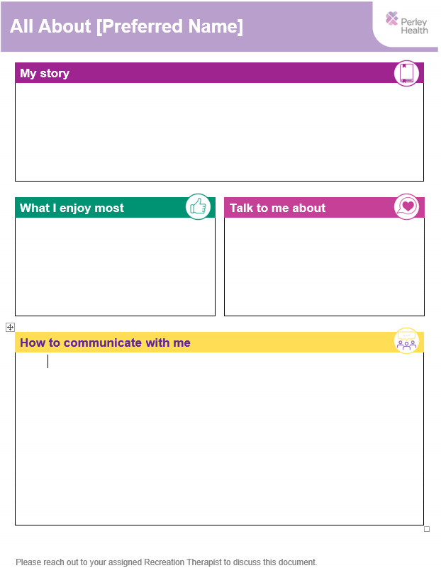

All About Me
Poster to be hung in resident’s
rooms

Slide 11
Implementation Timelines
Testing the Intervention
Implementation and Scaling
Apr
May &
June
July &
Sept
Oct &
Nov
Jan
Aug
Nov
Jan 2025
PDSA 1
Test the form and template
PDSA 2
Test the form to template data flow and accuracy
PDSA 4
Unit in Gatineau. Test admission process and catch up existing residents
Scale Gatineau building
Implement Unit in Ottawa
Scale Ottawa building
Implement Unit in Rideau
Scale Rideau building

Slide 12
Next Steps
Plan staff training for implementation with a focus on process and social engagement strategies.
High level discussions on subsequent projects

Slide 13
Leveraging technology to enhance resident engagement
Update on Magic Table

Slide 14

Tovertafel (Magic Table)
In 2023, Perley Health received a grant from CABHI Discover & Adopt Program to support implementing and evaluating this innovative solution as a means of enhancing resident social engagement
Initial 6-month trial period was conducted on R1N (new secure unit)

Slide 15
Tovertafel (Magic Table)
Implementation of the Magic Table is continuing across Perley Health, with three additional projectors being installed on G1S, O2W and in the Games Room
Planning is currently underway, including the
establishment of a “Champion Network” to support
roll-out and ongoing use

Slide 16
Dining Experience QI Team
Project Leads
Sarah Taylor, Manager, Food & Nutrition Supervisor
Colleen Summerton, PSW Supervisor

Slide 17
Area of Focus
“I enjoy mealtimes”
Initial change ideas:
Provide residents with their preferred meal choice
Serve all residents together (seated at the table)
Implement a sustainable table rotation plan
Visual (painting of dining rooms, updating window coverings, etc.)

Slide 18
Progress to Date
Testing change idea(s) (one unit - R2N)
  Taking orders of all residents seated at a table utilizing the resident census sheet (this will ensure all residents at the table are served together)
  Serving residents who choose to eat in their rooms following dining room service

Slide 19
Progress to Date
Budget approval received to update/refurbish dining rooms
Team met with an academic from Carleton University that specializes in LTC and built environment for suggestion/ideas on how to combine function (and regulation) with aesthetic

Slide 20
Next Steps
Evaluate current change ideas
  Are you receiving your meals together (with table- mates)?
  Are you receiving your meal choice more than 90% of the time?
Spread current changes to other areas of the home
Implement a Sustainable Table Rotation (R2N)
  To prevent same tables from always being served first/last

Slide 21
2023 Resident and Family Survey Results

Slide 22
Survey Methodology
 | Resident Survey | Family Survey
Survey Instrument | interRAI Quality of Life Survey | interRAI Family Survey on Nursing Home Quality of Life
Survey Dates | May - December | October - December
Response | 85 (of 137 eligible residents) | 68
Protocol Notes | Limited to residents with CPS 0-2 Administered by trained volunteer 5-pt Likert scale | Paper and electronic survey 5-pt Likert scale

Slide 23
Overall Results - Residents
Distribution of Responses - All Questions
35%
30%
25%
20%
15%
10%
5%
0%
Never
Rarely
Sometimes
Most of the time
Always

Slide 24
I would recommend this home to others
↑ is better
95%
90%
85%
80%
75%
70%
% Strongly Agree & Agree
#1
#2
2011
2012
2013
2014
2015
2016
2017
2018
2019
2020
2021
2022
2023

Slide 25
Overall Results – Family Survey
Survey average 80%, compared to 77% (2022)
Distribution of Responses - All Questions
60%
50%
40%
30%
20%
10%
0%
Never
Rarely
Sometimes
Most of the time
Always

Slide 26
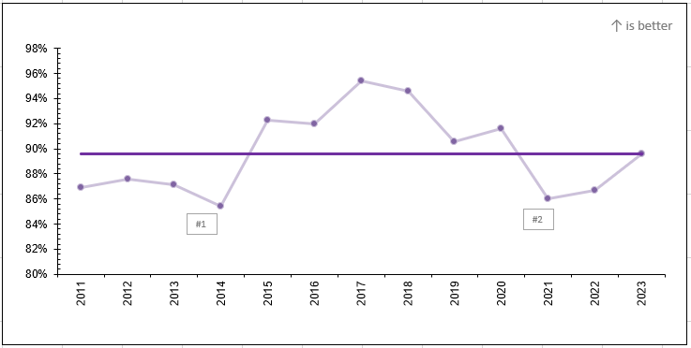

I would recommend this home

Slide 27
Comparing Resident vs Family QOL Results
Resident Survey Item | Resident | Family
I enjoy meal times | 53% | 52%
I have enough variety in my meals | 47% | 61%
I feel my possessions are secure. | 82% | 82%
If I need help right away, I can get it. | 65% | 65%
I feel safe when I am alone | 85% | 88%
I can be alone when I wish* | 74% | 87%
I can get the health services that I need | 81% | 77%
I would recommend this site or organization to others* | 78% | 90%
Staff pay attention to me | 81% | 84%
I am treated with respect by the staff | 89% | 97%
Staff respond quickly when I ask for assistance | 69% | 74%
I participate in meaningful activities. | 47% | 45%
Another resident here is my close friend | 22% | 7%

Slide 28
Themes – Higher Scores
Respect
  How staff treat resident (from both perspectives) and family members
  Privacy
Safety and security
Staff are attentive to residents and their needs
Participation in care decisions
Physical environment is clean and pleasant

Slide 29
Themes – Lower Scores
Social life
Food and dining experience
Caring staff (resident – staff bonding)
“home-like”
  This place feels like home to me (41%)
  There are comfortable places to visit with my family member (73%)

Slide 30
Next Steps
Continue focused attention
  Dining Experience
  Social Life/Activities
New additions to 2024/25 QIP
  “This place feels like home to me”
  Resident and Family Centred Care best practice guideline implementation

Slide 31
Quality Improvement Plan Update

Slide 32
2024/25 QIP Priorities
Improve the staff experience by continuing to implement “People First”
initiatives.
Improve the experience of residents by focusing on meaningful activities and mealtimes.
Improve the experience of family members by focusing on person-
centered communication and processes.
Reduce the percentage of residents without a diagnosis of psychosis taking antipsychotic medications.
Reduce the percentage of residents experiencing symptoms of
depression.
Reduce the percentage of residents experiencing potentially unmanaged pain.
Improve end-of-life care processes.

Slide 33
QI Highlights
Name tag redesign
PainChek pilot coming to Gatineau building
End-of-life symbol
Comfort care carts and sleeper chairs

