Slide 1



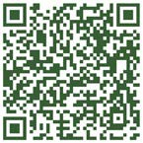

The Dementia Society of Ottawa and Renfrew County
The Dementia Society Centre 500-2327 St. Laurent Boulevard Ottawa, ON K1G 4J8
Call: (613) 523-4004
Toll Free: (888) 411-2067
eMail: info@dsorc.org
DementiaHelp.ca (bilingual website)
Charitable Registration Number: 11878 5013 RR0001
1

Slide 2

What is Dementia?
Perley Health Family and Friends Council

Slide 3
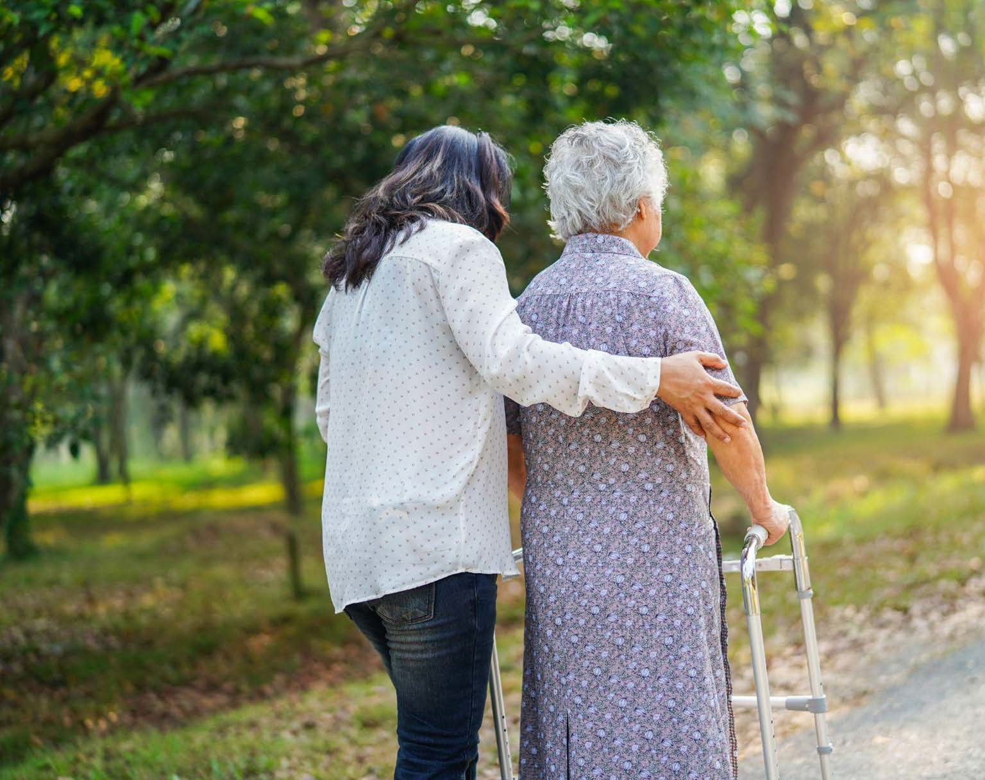
What is Dementia?

Slide 4
Today’s Presentation:
Defining Dementia
Types of Dementia
Young Onset Dementia
Dementia by Numbers
The 10 warning signs
Risk Factors
The scope and impact
Where can I get help?
What is Dementia?
4

Slide 5
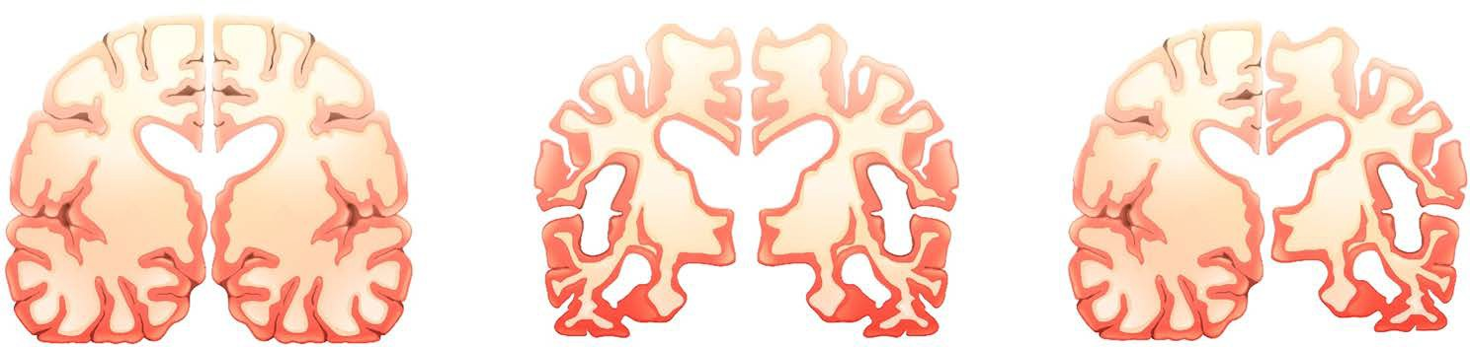

DEFINING DEMENTIA
PROGRESSIVE
Damage from the disease increases overtime
DEGENERATIVE
Brain cells degenerate or break down
IRREVERSIBLE
Damage cannot be repaired; at present there is no known cure.

Slide 6

Dementia:
Is a progressive, chronic illness
Affects the individuals living with it, their caregivers, families and more
Becomes increasing more challenging as it progresses
Currently has no cure
Is not contagious
Some treatments may help to ease symptoms for some people and can help improve quality of life.

Slide 7

What is Dementia?
Dementia is an umbrella term that describes a set of symptoms affecting brain function. It's a chronic condition that gets more severe over time and is often characterized by:
It's a chronic condition that gets more severe over time and is often characterized by:
A decline in:
Memory
Planning
Language
Judgement
Physical changes like:
Loss of coordination
Loss of bladder control
Weak and stiff muscles
Trouble standing, sitting or walking
And changes in mood and behaviour.

Slide 8

TYPES OF DEMENTIA
Alzheimer’s Disease
Dementia with Lewy Bodies
Frontotemporal Dementia Vascular Dementia
Parkinson’s Disease Dementia Mixed Dementia

Slide 9

What causes dementia?
There are many different types of dementia, each with its own cause.
We don't yet fully understand these causes, but researchers suspect that some may be:
Abnormal proteins in the brain
Reduced blood supply to the brain
Nerve cells in the brain that stop working properly

Slide 10


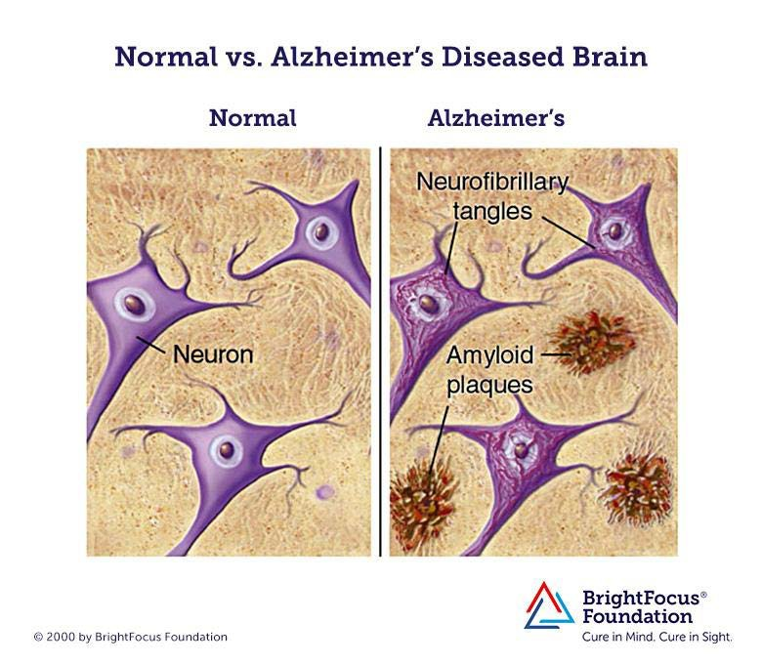
Alzheimer Disease: Micro
Tau protein
Amyloid β protein
10

Slide 11
Types of Dementia
There are over 100 diseases that sit under the umbrella term for the symptoms that are caused by dementia.
There are many forms of dementia, including Alzheimer’s disease. Symptoms vary depending on the type.
Alzheimer’s Dementia
Alzheimer’s disease is a chronic neurodegenerative disease that destroys brain cells, causing thinking ability and memory to deteriorate over time.
Frontotemporal Dementia
Frontotemporal dementia is an umbrella term for a group of rare disorders that primarily affect the areas of the brain associated with personality and behaviour.
Mixed Dementia
More than half of all people with Alzheimer’s Disease also have another type of dementia. For example, Alzheimer’s Disease and Vascular Dementia often occur together.
Vascular Dementia
Vascular dementia occurs when the brain’s blood supply is blocked or damaged, causing brain cells to be deprived of oxygen and die.
Lewy Body Dementia
Dementia with Lewy bodies is caused by abnormal ‘Lewy bodies’ deposits of protein called alpha-synuclein inside of the brain’s nerve cells and shares similarities with Parkinson’s disease.
Parkinson’s Dementia
Parkinson’s disease dementia is a decline in thinking and reasoning skills that develops in some people living with Parkinson’s. As brain changes caused by Parkinson’s gradually spread, the person may also experience changes in mental functions, including memory.

Slide 12

Young Onset Dementia
About 3% of all people living with dementia in Canada are younger than age 65. This is known as young onset dementia.
Young onset is not a type of dementia, it simply describes the time of onset versus typical onset. The type could be Alzheimer's, vascular, dementia as a result of brain trauma, etc.
Since dementia is less common before age 65, young onset often goes unnoticed or undiagnosed.

Slide 13
“On average, nine seniors are diagnosed with dementia every hour in Canada.”
Public Health Agency of Canada, Canada’s First Dementia Strategy (2019)
“Every day, more than 350 people in Canada develop dementia. This is more than 15 every hour.”
The Alzheimer’s Society of Canada 2022 Landmark Study

Slide 14
Dementia by the Numbers
Dementia affects not only the person living with it, but it has a broad-reaching impact on families, the healthcare system, our communities and more
People Living with Dementia
Caregivers
2050 (3)
1,700,000
2050 (3)
1,000,000
2022 (1)
569,600
2022 (3)
350,000
Dementia in Canada

Slide 15
Dementia by the Numbers
65% of Canadians diagnosed with dementia over the age of 65 are women.
Women living with dementia
Men living with dementia
2050
1,053,200
2050
616,000
2022
352,300
2022
217,300
Every day, more than 350 people in Canada develop dementia.
This is more than 15 every hour.

Slide 16
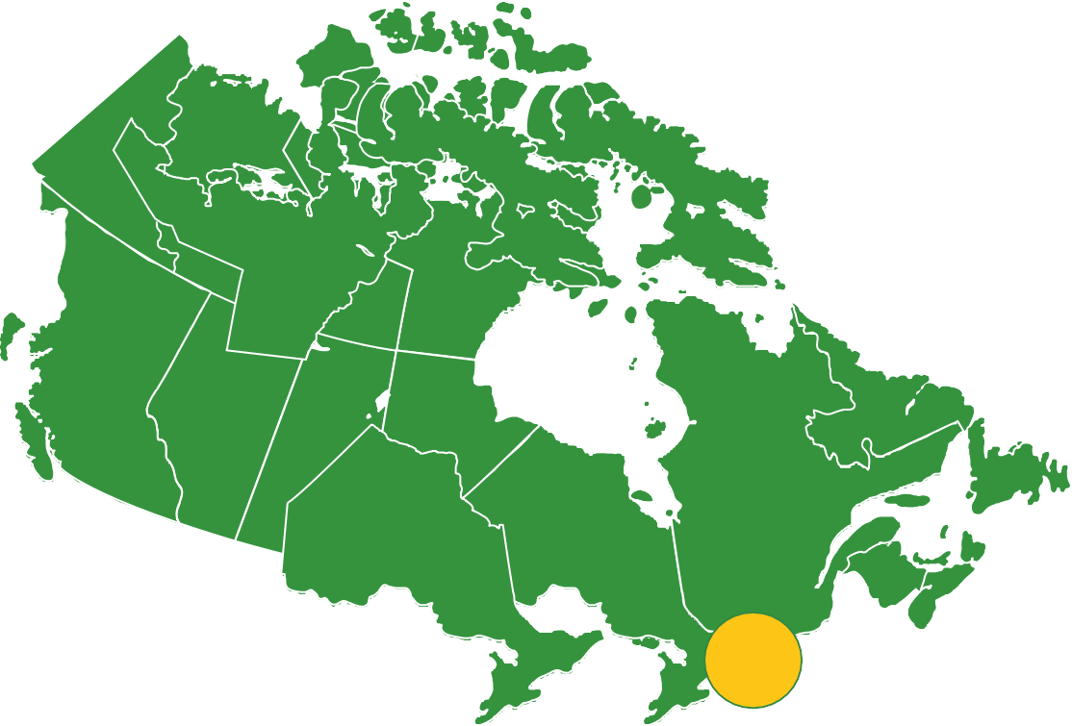
Dementia in our Communities
Canada’s rapidly aging population means we will continue to see ongoing increases in the
number of people affected by dementia.
The dementia population in Ottawa and Renfrew County in 2023 is 24,000. By 2050, that number is expected to more than double to 60,000.

Slide 17
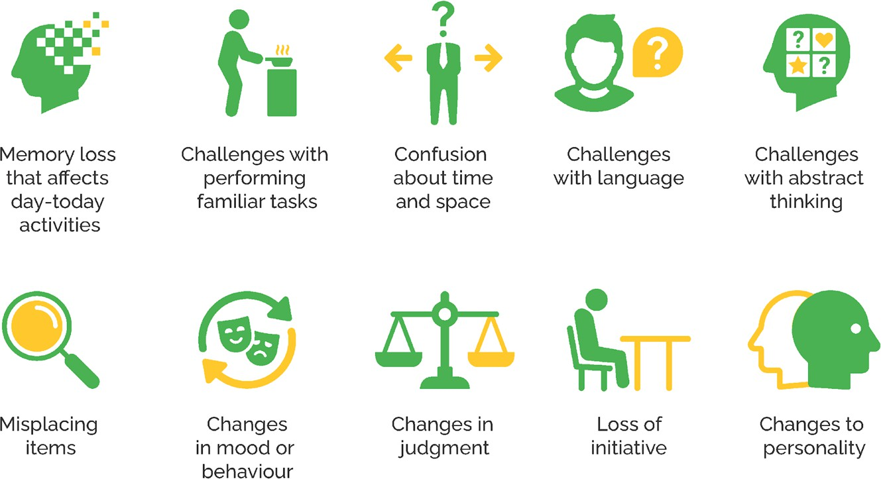
Possible warning signs

Slide 18
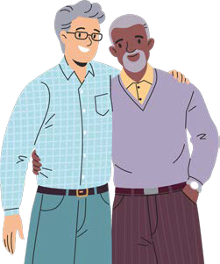
Dementia is about more than memory
Normal aging behaviours:
Behaviours associated with dementia:
Losing an item occasionally
Feeling tired and wanting to stay at home
Forgetting an appointment
Forgetting what day it is occasionally
Getting irritated when one’s normal routine is
altered
Making a bad decision occasionally (finances)
Constantly putting items in strange places
Removing oneself from favourite activities, hobbies due to forgetfulness or difficulty completing
Forgetting recently learned information or having to ask for it over and over. Increasing reliance on others to complete tasks
Completely losing track of day or season
Getting extremely agitated by a change in routine
Constantly exhibiting poor financial decision-making

Slide 19
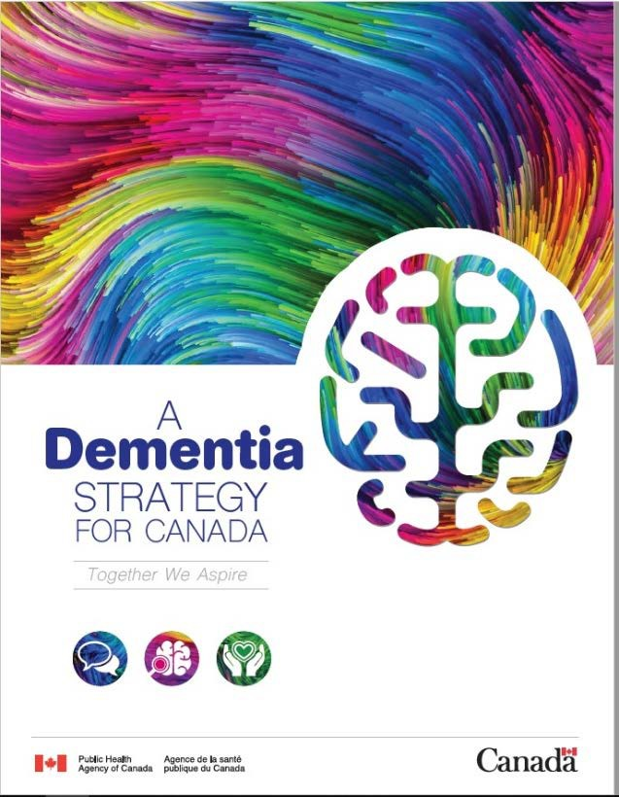
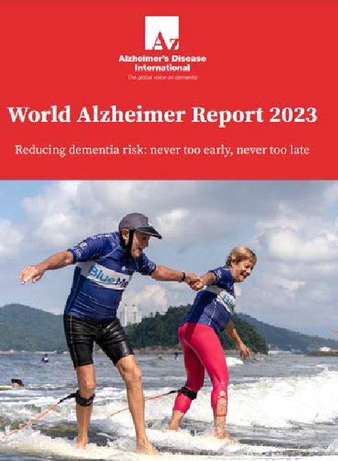

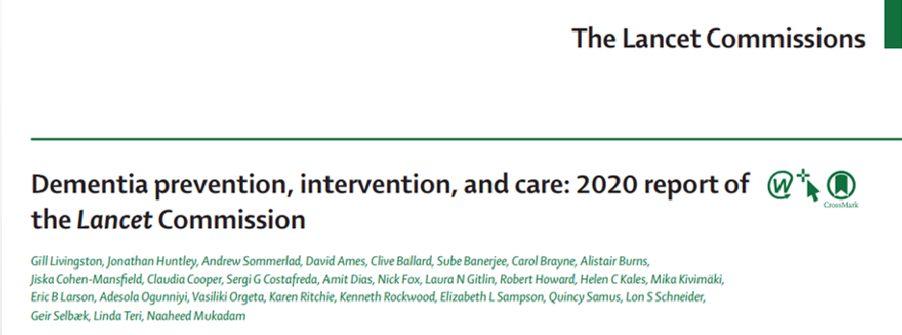
Dementia: Risk factors and prevention
Dementia Strategy Canada
Lancet Commission's Report 2020
World Alzheimer Report 2023
Reducing Dementia Risk: never too early, never too late

Slide 20
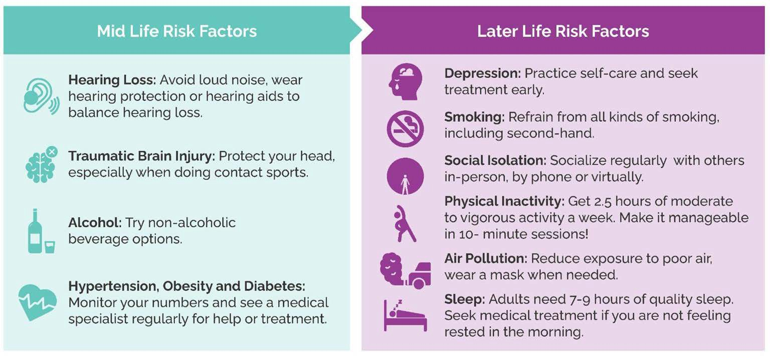

Slide 21
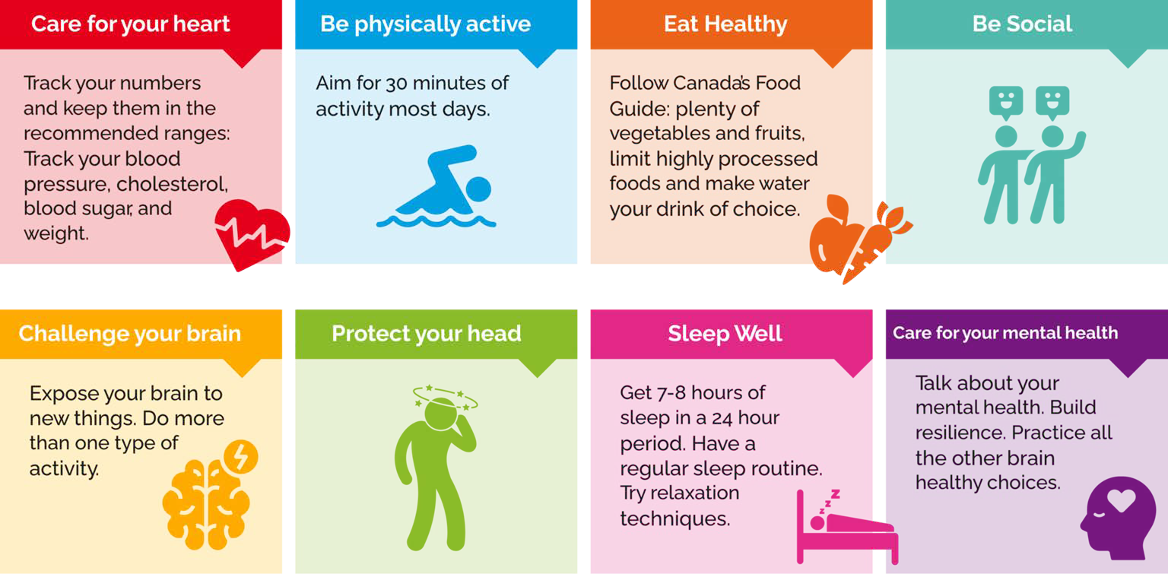

Slide 22





Where have you experienced dementia in your life?
Your Spouse?
Your Parent?
Your Sibling?
Your Colleague?
Your Best Friend?

Slide 23
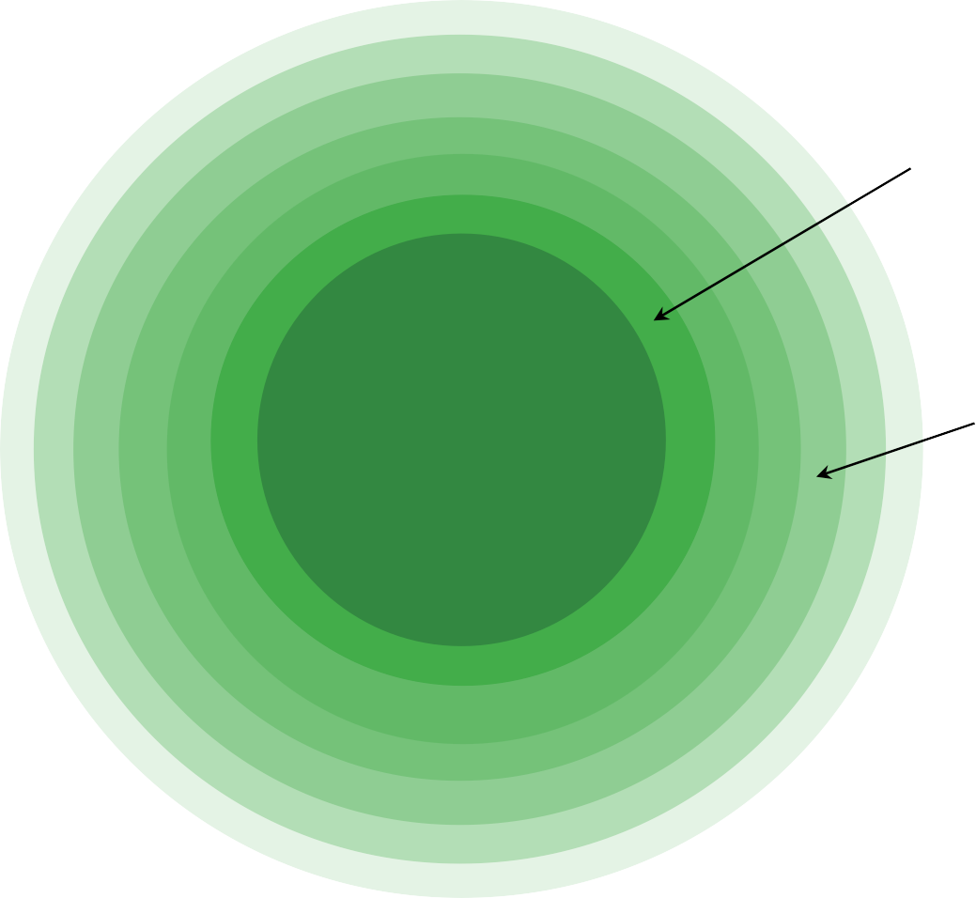
The Scope and Impact of Dementia
Caregivers, family, workplaces, community and our healthcare system are all impacted by dementia
Caregivers
Family Members
People Living with Dementia
Community
Workplaces
Healthcare System
General Public

Slide 24
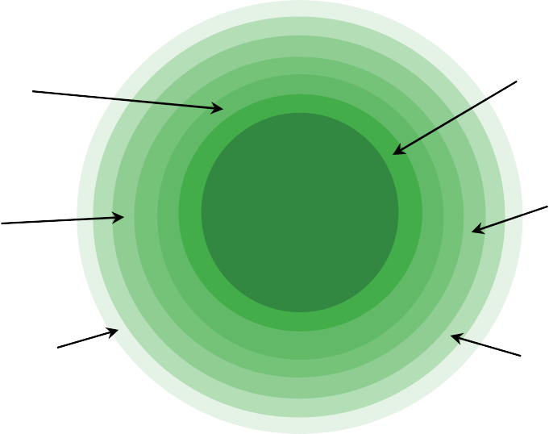
Caregivers
The Scope and Impact of Dementia
1 in 5 Canadians is supporting someone living with dementia.
On average a caregiver to a person living with dementia in Canada contributes 26 hours a week.
In our region, almost 60% of caregivers living with a person living with dementia provide more than 40 hours of care a week, which equates to a full time job.
Family Members
Caregivers
Unpaid female caregivers experience more stress than male caregivers.
Workplaces
PLWD
Community
Women account for 70% of family caregivers and 80% of professional caregivers.
Healthcare System
General Public

Slide 25
1 in 5 Canadians have experience caring for someone living with dementia
Your Spouse?
Your Parent?
Your Sibling?
Your Colleague?
Your Best Friend?

Slide 26




5 Hopeful Factors
40%
40% of dementias are preventable
There is support for people facing dementia
There are currently some medications which may benefit some people
There is research to find therapies to treat the known causes of dementias
There is research to better understand the causes of the many forms of dementia

Slide 27
2024
Dementia Updates
Population impact
Prevention
Early detection
New treatments
By 2050, one out of every four people who develop dementia in Canada will be of Asian origin.
Alzheimer Society of Canada, 2024
Risk factors identified for young-onset dementia
Hendriks et al.,JAMA Neurology,
2023
We are on the brink of having a blood test for Alzheimer's disease.
Ashton et al.,JAMA, 2024
New Alzheimer’s Drug approved by US FDA Raises Hopes
Dyck et al.,NEJM, 2023
Dyck et al. New England Journal of Medicine 2023;388:9-21.
Alzheimer Society of Canada. (2024). The many faces of dementia in Canada: The Landmark Study Report #2. https://alzheimer.ca/sites/default/files/documents/ASC_The%20Many%20Faces%20of%20Dementia%20In%20Canada_Landmark%20Study_Vol2.pdf

Slide 28
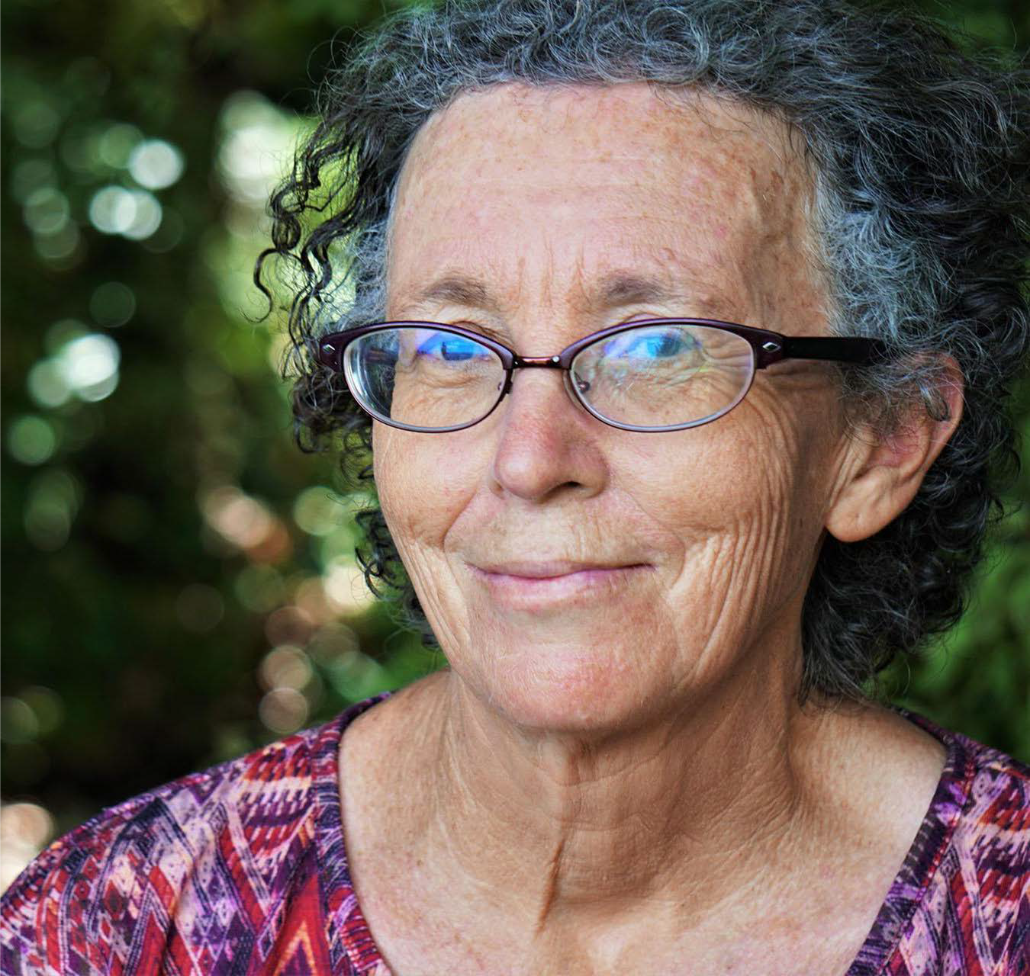
Where can I get help?

Slide 29
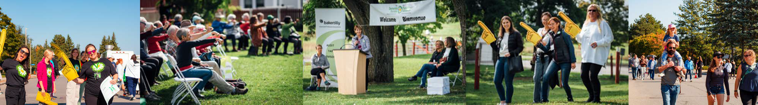
Dementia Society
of Ottawa and Renfrew County
Since 1980 we have been the local resource for community-based dementia support, education and programs for those living with dementia, their caregivers and families.

Slide 30

When do Persons Living with Dementia, Caregivers, and Families Need Help?
At the point of first diagnosis and points of change.
When psychological and behavioural symptoms occur.
When functioning is declining
At any point in a person's journey

Slide 31
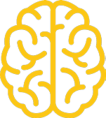

The Dementia Society of Ottawa and Renfrew County delivers the practical and emotional support, education and programs to increase quality of life for all people impacted by dementia.
The Dementia Society Continuum of Dementia Care
Dementia Awareness, Prevention & Inclusions
Tailored Coaching
Practical & Emotional Support for Caregivers
Social and Recreational Activities
Education

Slide 32
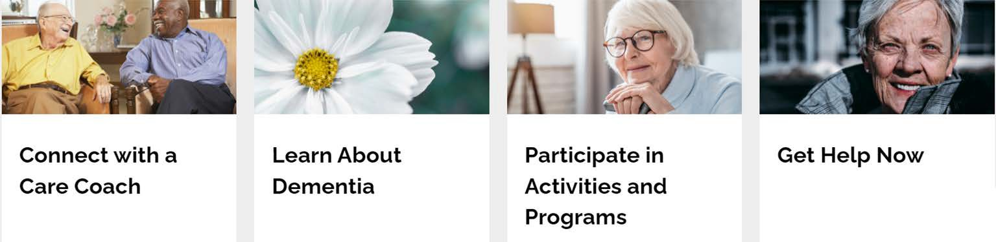
The Dementia Society Website Learn, Discover and Participate
Explore our Programs, Activities and Services.
Visit www.DementiaHelp.ca

Slide 33
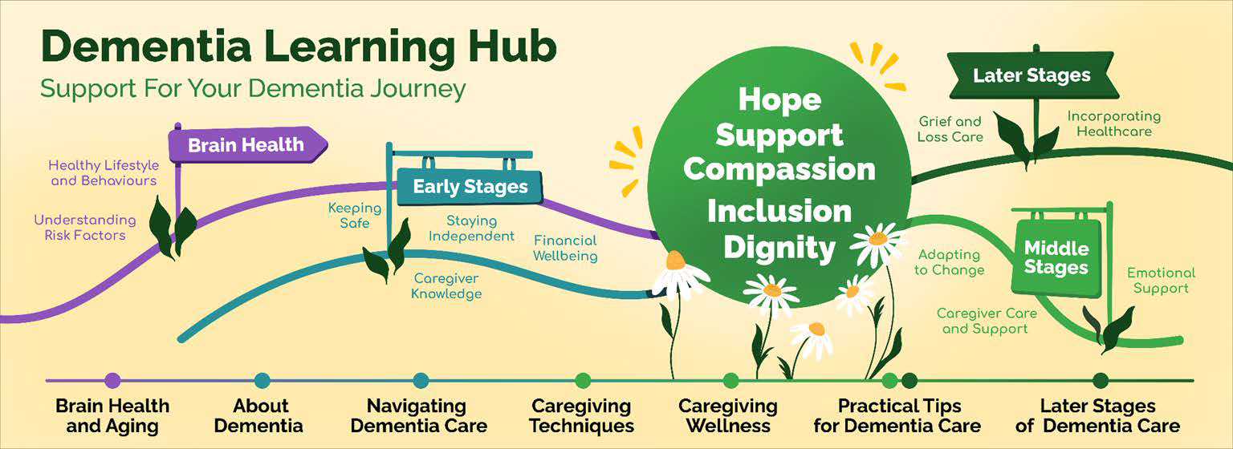
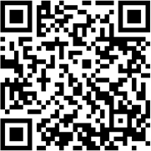
Our Dementia Learning Hub
https://DementiaHelp.ca/dementia-learning-hub/

Slide 34



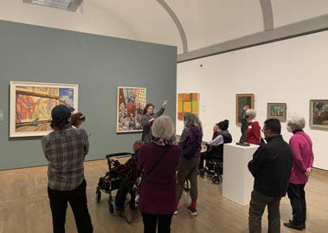
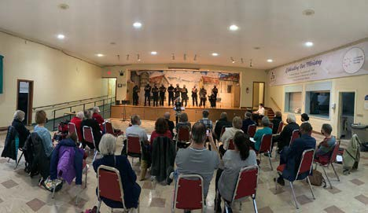

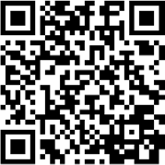
Social and recreational programs
Arts and Minds series is an opportunity for people living with dementia and a companion to create, explore and experience art.
Musical Connections series provides opportunities to experience a live, in-person or virtual musical performances.
Donations fund associated costs to offer programs at no-charge.

Slide 35


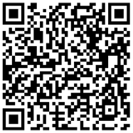
Community Support
The Dementia Society is only partially- funded by Ontario Health to provide core education and support services. With community support we offer free social and recreational programs and education outreach.
Individual and corporate contributions, and volunteer time and expertise allow us to offer our programs and services at no cost.
Donate today!
So that here, no one faces dementia alone.

Slide 36
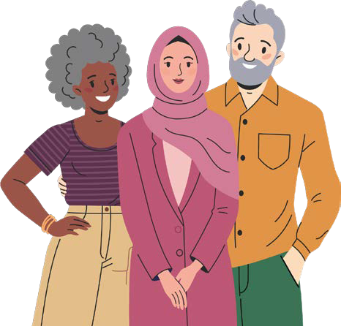
Main Takeaways
Dementia affects us all.
The are ways to prevent dementia.
If you are a Caregiver, you don't have to do this alone.
Let’s make a more Dementia Inclusive community.
The Dementia Society of Ottawa and Renfrew County is here for you.

Slide 37
The Dementia Society of Ottawa and Renfrew County
The Dementia Society Centre 500-2327 St. Laurent Boulevard Ottawa, ON K1G 4J8
Call: (613) 523-4004
Toll Free: (888) 411-2067
eMail: info@dsorc.org
DementiaHelp.ca (bilingual website)
Charitable Registration Number: 11878 5013 RR0001
37

