Slide 1
Nurses Supporting Nurses
Nursing Orientation Peer Support Program Orientation Partner Training:
Slide Deck
A slide deck presentation to formally train point-of-care nurses to become Orientation Partners within the Nursing Orientation Peer Support Program (NOPSP).
Note to implementing long-term care home:
This presentation is intended to prepare nurses for the role of Orientation Partners within a home that is implementing a NOPSP. In full, it is a 4-hour training, but it can be shortened, edited, and tailored to your home’s individual needs. Text in [Green] may need to be personalized, such as names. The training is designed to be meaningful and engaging. It takes a blended learning approach and includes teaching exercises that are experiential, collaborative, self-reflective, and that spark discussion.
An accompanying facilitator’s guide is also available to explain the activities and teaching content of this slide deck. Please see Toolkit Resource 7: Nursing Orientation Peer Support Program Orientation Partner Training Facilitator’s Guide

Slide 2

Implementing a NOPSP in Long-Term Care
This training deck, as well as the facilitator’s guide, are part of a larger toolkit to support long-term care homes to implement a NOPSP.
For more resources, including a full implementation guide, please see Perley Health’s Nurses Supporting Nurses: Building an Orientation Peer Support Program.
PerleyHealth.ca/orientation-peer-support-program

Slide 3
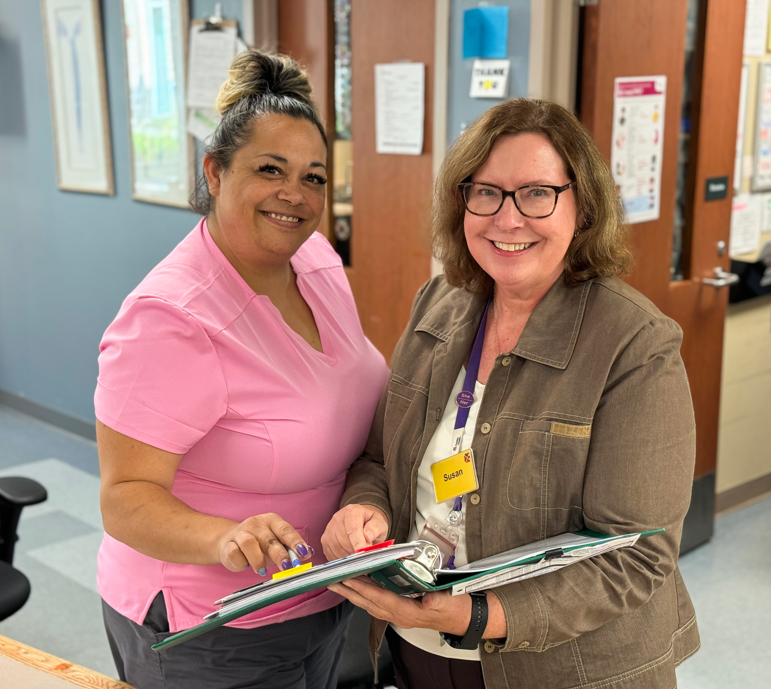
Nurses Supporting Nurses
Nursing Orientation Peer Support Program
Orientation Partner Training

Slide 4
Learning Objectives
Describe the purpose of the NOPSP and the role of the Orientation Partner.
Apply principles of effective peer support, mentorship and relationship building when supporting a newly hired nurse.
Reflect on their own strengths, experiences, and areas of growth as an Orientation Partner.

Slide 5
Overview of Training
Introduction to the Nursing Orientation Peer Support Program (NOPSP)
Collaborative learning approach
Key principles of peer support
Communication
Fostering resilience
Creating a safe learning environment
Adapting to individual needs
Self-reflection

Slide 6
Icebreaker
What is your name?
What is your role/designation?
How long have you been a nurse?
How long have you worked at [Home Name]?
What was your experience transitioning into your role?

Slide 7
Nursing Orientation Peer Support Program (NOPSP)
A Nursing Orientation Peer Support Program (NOPSP) is a structured initiative designed to support newly hired nurses as they transition into practice within our team at [Home Name].
Orientation Partners are paired with a new hire nurse during their first 6-weeks of independent practice.

Slide 8
What is an Orientation Partner
A direct point-of-care RPN or RN who is paired with a newly hired nurse to:
Provide peer support and mentorship
Facilitate integration into the team and culture of the home
Promote a positive onboarding experience

Slide 9
Within the Scope of an Orientation Partner | Outside the Scope of an Orientation Partner
Answer questions Guide the new hire to policies, procedures, and other resources Share personal experiences of onboarding Discuss concerns, offer advice, and support new hire in problem solving Promote confidence and encourage new hire Provide constructive feedback | Demonstrate clinical skills Offer informal buddy, or shadow, shifts Complete tasks for the new hire Develop and monitor a performance improvement plan Offer peer support outside of scheduled work hours

Slide 10
Why do we need peer support?
Research suggests that:
Having peer support at onboarding can help newly hired nurses feel more supported in their transition into the profession – higher job satisfaction
Mentorship and peer support help nurses develop critical thinking, problem-solving abilities
Provides a safe space to ask questions and gain confidence
Improved patient outcomes, through better communication skills
Emotional support, offer encouragement and help newly hired nurses navigate the emotional aspects of patient care

Slide 11
What Makes An Effective Orientation Partner?
Activity
Group Task: Think about the qualities that make an effective Orientation Partner. Write them down.

Slide 12
Effective Peer Support Relationships
Experienced and Knowledgeable:
Empathetic and Supportive:
Good Communicator:
Patient and Understanding:
Approachable and Trustworthy:
Encouraging and Motivating:
Adaptable and Flexible:
Professional and Ethical:
Strong Problem-Solving Skills:
Building a strong peer support relationship involves creating an environment where your new hire feels heard, understood, and supported.
Notes:
More in handbook
Talk about my experience in clinicals

Slide 13
Communication Strategies For Effective
Peer Support
Group activity:
Work in pairs to draw a line, but with one key challenge
You cannot speak or write instructions.
Each person has a blank sheet of paper and a pen
One person will start drawing, while the other will try to replicate it based solely on non-verbal cues without looking at each other's paper
Notes:
Note : That was interesting, wasn’t it? Let’s take a moment to reflect. How did that feel when you were given no instructions? What were the challenges? What would have made this exercise easier? These frustrations can happen in real-life communication, especially in mentorship. Clear communication is essential, and sometimes our assumptions or lack of clarity can lead to confusion and mistakes.

Slide 14
Effective Communication Techniques
Non-verbal communication:
What it is: Using body language, eye contact, tone of voice, and facial expressions to enhance your message
Why it’s important: Non-verbal cues can reinforce empathy, support, and openness. Positive body language (nodding, leaning slightly forward).
Empathy:
What it is: Understanding and acknowledging the new hire's feelings and perspectives, without judgment.
Why it’s important: Empathetic communication creates a safe space for the newly hired nurse to open-up. It shows that the Orientation Partner genuinely cares about the newly hired nurses’s emotional and professional well-being, fostering a more supportive peer support relationship .

Slide 15
Effective Communication Techniques
Positive Reinforcement
What it is: Providing encouragement and constructive feedback that emphasizes strengths and progress (e.g., "You're doing great, and I can see you're improving in this area.").
Why it’s important: Positive reinforcement motivates the new hire, boosts their confidence, and helps them stay engaged in their learning and development. It encourages growth through affirmation and support
Clarification and Paraphrasing
What it is: Restating or summarizing what the new hire has said to ensure clarity and prevent misunderstandings (e.g., "So, what I'm hearing is that you're feeling overwhelmed by your current workload. Is that right?").
Why it’s important: Clarification helps ensure that both the Orientation partner and newly hired nurses are on the same page. It prevents miscommunication and allows the new hire to correct any misunderstandings before they escalate

Slide 16
Fostering Resilience
Resilience is vital in the nursing profession. It helps us face the challenges of the job without burning out.
Group Activity:
Discuss how you’ve maintained your resilience in tough times, in your nursing career. What strategies have worked for you?

Slide 17
Fostering Resilience
1.Encourage Self-Awareness
What it is: Help new nurses identify their personal stressors, triggers, and emotional responses to challenging situations.
Why it’s important: By recognizing their stressors, new nurses can better understand how to manage and cope with them (Mealer & Jones, 2017).
2. Promote Stress Management - Techniques
What it is: Encourage mindfulness, breathing exercises, and time management strategies to help new nurses manage stress.
Why it’s important: These techniques can reduce burnout and enhance emotional regulation (Lambert et al., 2020).
3. Build a Support Network
What it is: Encourage new nurses to build strong relationships with colleagues and engage in peer support groups
Why it’s important: A strong professional network offers new nurses a sense of community and mutual support (Lambert et al., 2020).
4. Encourage Reflection and Problem-Solving
What it is: Guide new nurses in reflecting on their experiences and exploring ways to overcome challenges.
Why it’s important: Reflection fosters critical thinking and problem-solving, which are essential skills for building resilience (Mealer & Jones, 2017).

Slide 18
Wellness Break
15 minutes

Slide 19
Creating A Safe Learning Environment
A safe learning environment is crucial for newly hired nurses to thrive.
What does this environment look like?
It’s one where trust, mutual respect, and open communication are prioritized. When we build psychological safety, newly hired nurses are more likely to take risks, ask questions, and make mistakes—essential for learning.

Slide 20
How can you create a safe learning environment?
1. Establish trust and mutual respect
What it is: Build trust by demonstrating honesty, reliability, and consistency. Show respect for the new hire's experiences, opinions, and emotions.
1
2. Foster a non-punitive feedback culture
What it is: Provide constructive feedback in a supportive manner, focusing on development rather than punishment. Use feedback as a tool to enhance skills and promote self-improvement.
2
3. Model Vulnerability and openness
What it is: As an Orientation Partner, model vulnerability by sharing your own mistakes and the lessons learned from them. Be open about your own growth process.
3

Slide 21
Creating Safe Learning Environments
Review 3 scenarios and discuss how you would create a supportive environment for each.

Slide 22
Revisiting the Role of the
Orientation Partner
As an Orientation Partner, you are a guide and supporter, but you’re not expected to solve every problem or become a substitute for formal training.
Note: We’re here to support the learning process, not to provide personal counseling or take over tasks that the mentee can do themselves.

Slide 23
Adapting to Individual Needs
Review the case studies and follow the discussion prompts.
Considerations:
What are underlying individual needs?
  Guidance vs autonomy
  Feedback vs emotional support
  Fostering autonomy vs advocating for additional
  Patience vs setting a boundary
  Disrespect vs world view differences
2. How would you adapt your approach to support them?
3. In what ways are the two similar? different?

Slide 24
Wellness Break
15 minutes

Slide 25
Self-Reflection as an Orientation Partner
Reflect on today’s learning and your current abilities as an Orientation Partner.
Write one SMART goal to improve.
Identify one step you can take tomorrow to build your skills.
Specific, Measurable, Attainable, Relevant, Timely

Slide 26
Key takeaways
Understand the value of a NOPSP and define the role of the Orientation Partner.
Use effective peer support, mentorship, and relationship-building strategies.
  Clear communication.
  Fostering resilience.
  Creating a safe learning environment.
  Adapting to individual needs.
  Self-reflection.
Recognize their strengths and identify opportunities for growth as an Orientation Partner.

Slide 27
Evaluation
Tell us what you thought of this training!
[Insert Completion Instructions Here]
Notes:
This slide is optional, depending on whether you have an evaluation or not.

Slide 28
Thank you!
Thank you for taking the time to become an Orientation Partner.
Your support, encouragement, and experience can make a meaningful difference in a newly hired nurse’s transition to practice.
We appreciate your commitment to supporting your colleagues and strengthening our nursing team.

Slide 29

References
A complete reference list is available upon request.
This training was developed at Perley Health Centre of Excellence.

Slide 30

Conclusion
Thanks for participating today!
[Insert Contact Information]

